Slide 1
Service NSW Analytical Assessment
Prepared By Mohammad Tarequl Islam

Slide 2
Before starting the Analysis
I kept the raw data and create copy of data set so that if anything goes wrong I can retrieve the data.
Data quality checks, data wrangling
Remove the duplicates as I am assuming we should have unique Invoice Number.
Checking the missing values.
I have used Excel and Power BI to perform the analysis.
Identify the calculated columns, measures, data modelling if needed

Slide 3
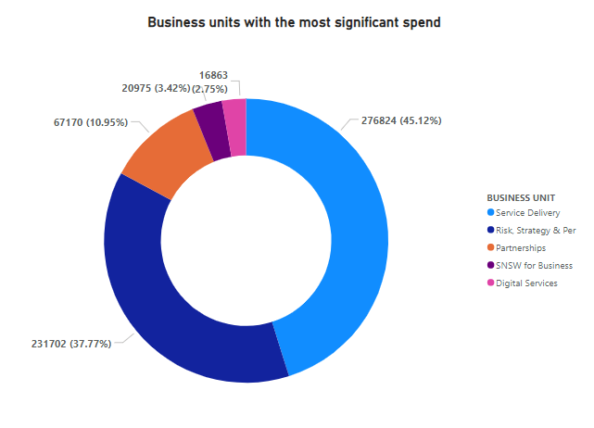
✳Above chart clearly showing that Service delivery in Business Units has the most significant spend and Digital service has spent the least.

Slide 4
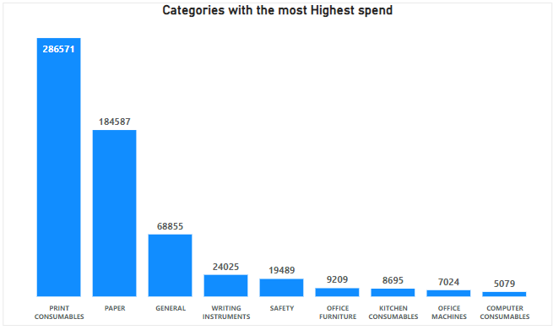
✳Print Consumables has the highest spend and the total spent amount is $286571.

Slide 5
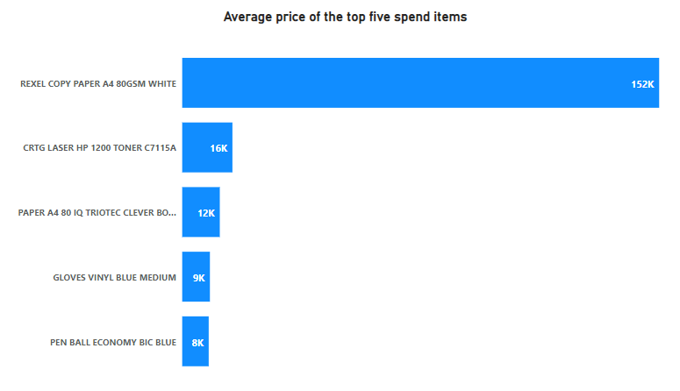
The average price paid for each of the top five spend items and Rexel Copy Paper A4 850GSM white has the highest average price paid.

Slide 6
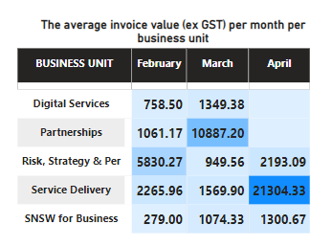
The average invoice value (ex GST) per month per business unit. I assumed the total spend ( Unit price * quantity purchased) including GST. I have used some formula to deduct the GST. In April, service delivery unit spent the highest average invoice value.

Slide 7
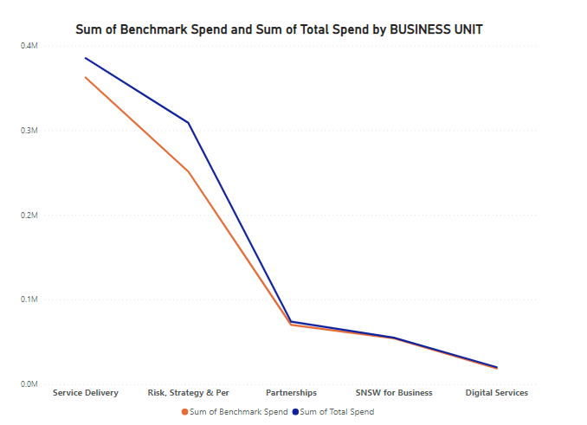
I have analysed the total spend by business unit with benchmark unit cost and current unit price. Service delivery unit has the highest with benchmark unit cost and current unit price. Digital services, SNSW for Business and Partnerships are pretty consistent and those units has the potential savings capability.
* In this Question I need more clarification. For doing it, I will setup a meeting with my senior manager.

Slide 8
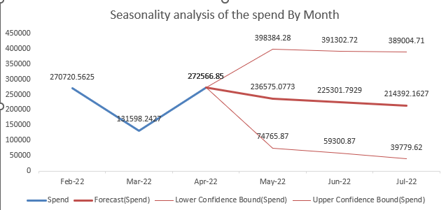
I have done the Seasonality analysis of the spend for the next 3 months. I have used some advanced Excel formula to do the Seasonality analysis. I have cross checked with Excel feature call forecast sheet as well. Orange line indicating the seasonality spend of next 3 months.

Slide 9
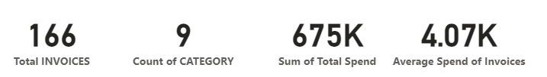
(8) What other analysis could you have conducted given the data contained in the single dataset you have created?
I would analyze some more KPIs such as
Total invoices
Total category
Sum of the Total Spend
Average spend of per invoice
I have added the monthly slicer into dashboard so that Client can see the dashboard easily on a monthly basis.

Slide 10
(9) What additional data or information would you require to conduct further analysis & what value would it add to the presentation?
I need some more additional data such as goods receive date, supplier name whether its own product or from third party, discount price , Ordering/Approval employee, payment days, Office Code to find out which city’s office spending most.
I conduct weekday basis analysis to find out whether total spend is higher when staff working at onsite ?

Slide 11
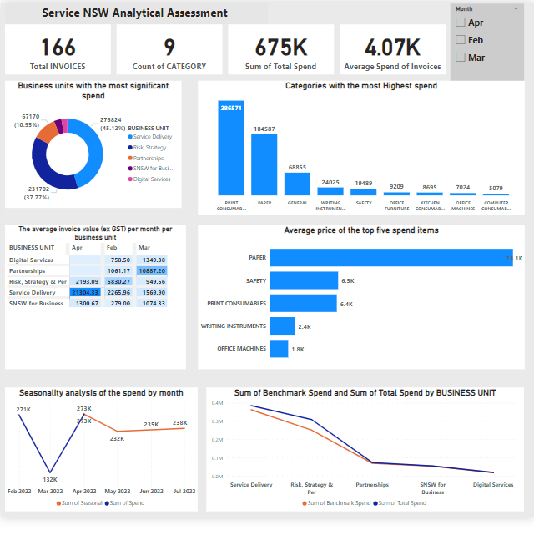
Service NSW Dashboard

